Slide 1

FLIGHT OPERATIONS
Analytics
Dashboard & Data Analysis
Graduation Project | Data Analysis Track
Digital Egypt Pioneers Initiative (DEPI)
June 2025
eyouth
رواد مصر الرقمية | وزارة الاتصالات

Slide 2



رواد مصر الرقمية
وزارة الاتصالات
وتكنولوجيا المعلومات
Project Idea
Understanding flight operations through data
Problem Statement
Proposed Solution
Unique Value
Flight delays cause significant economic losses
Airlines struggle to identify key delay drivers
Passengers face poor travel experience due to delays
Analyze 5.8M+ flight records across US airlines
Build interactive Power BI dashboards
Use MySQL for deep data exploration
End-to-end pipeline: SQL → Power BI
Multi-dimensional delay analysis
Actionable insights for airlines & travelers
June 2025
Flight Operations Data Analysis
eyouth
2

Slide 3
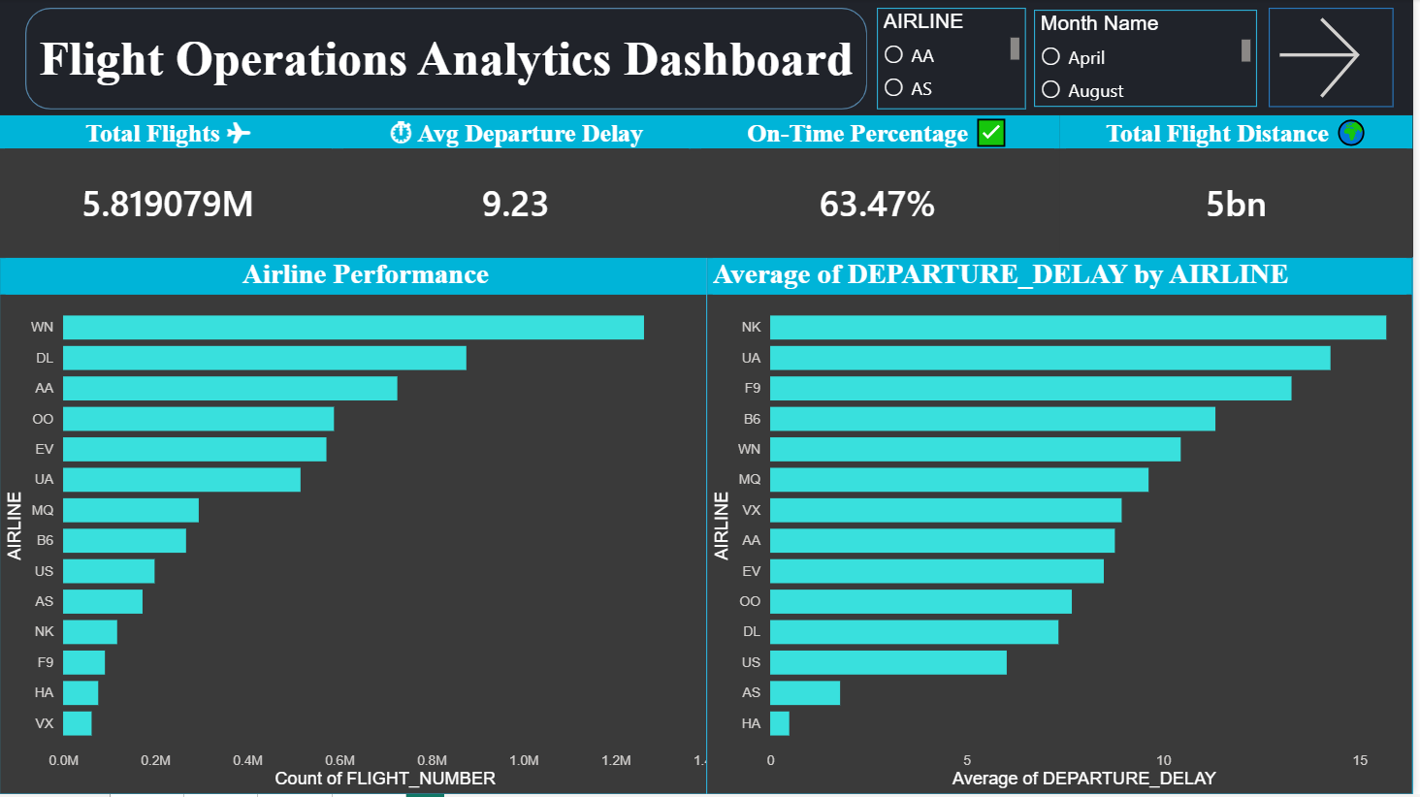


رواد مصر الرقمية
وزارة الاتصالات
وتكنولوجيا المعلومات
Project Wireframe
Power BI Dashboard — Key user interfaces
5.82M Total Flights
9.23 min Avg Delay
63.47% On-Time %
5 Billion Miles
June 2025
Flight Operations Data Analysis
eyouth
3

Slide 4

رواد مصر الرقمية
وزارة الاتصالات
وتكنولوجيا المعلومات
End Users + Features
Who benefits and what they get
End Users
Key Features
Airline Managers
1
Airline Performance Ranking
Track fleet performance & delay patterns per airline
Compare all 14 airlines by flight count & delay
2
Airport Volume Analysis
Airport Operations
Top 10 busiest airports with drill-through
Monitor top airports by volume & congestion hotspots
3
Delay Category Breakdown
Early / On-Time / Moderate / Severe split
Data Analysts
Drill down into monthly heatmaps and delay categories
4
Monthly Heatmap
Color-coded delay matrix by airline × month
Travelers & Agencies
5
Geographic Distribution
Identify best airlines and routes for on-time travel
628 airports mapped across 54 states
June 2025
Flight Operations Data Analysis
eyouth
4

Slide 5
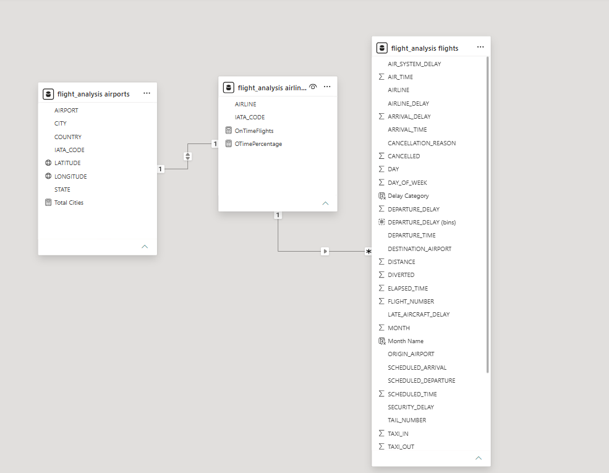
رواد مصر الرقمية
وزارة الاتصالات
وتكنولوجيا المعلومات
Data Structure
Relational data model — Power BI / MySQL
flight_analysis.flights
AIRLINE, FLIGHT_NUMBER, ORIGIN_AIRPORT,
DESTINATION_AIRPORT, DEPARTURE_DELAY,
ARRIVAL_DELAY, DISTANCE, CANCELLED…
flight_analysis.airlines
IATA_CODE, AIRLINE
(+ calculated: OnTimeFlights, OTimePercentage)
flight_analysis.airports
IATA_CODE, AIRPORT, CITY, STATE,
COUNTRY, LATITUDE, LONGITUDE
airlines ← 1:* → flights | airports ← 1:* → flights
June 2025
Flight Operations Data Analysis
eyouth
5

Slide 6
رواد مصر الرقمية
وزارة الاتصالات
وتكنولوجيا المعلومات
Tech Stack
Programming Languages + Tools & Frameworks
Database & Querying
Visualization
MySQL
Schema design, complex queries, aggregations, GROUP BY, LIMIT, subqueries
Power BI
DAX measures, data modeling, interactive dashboards, slicers, heatmaps
Data Transformation
Business Logic
Power Query
ETL pipeline: import, clean, shape, and merge tables from CSV sources
DAX
Calculated columns: OnTimeFlights, OTimePercentage, Delay Category bins
June 2025
Flight Operations Data Analysis
eyouth
6

Slide 7
رواد مصر الرقمية
وزارة الاتصالات
وتكنولوجيا المعلومات
Dashboard 1
Airline Performance Overview
June 2025
Flight Operations Data Analysis
eyouth
7

Slide 8
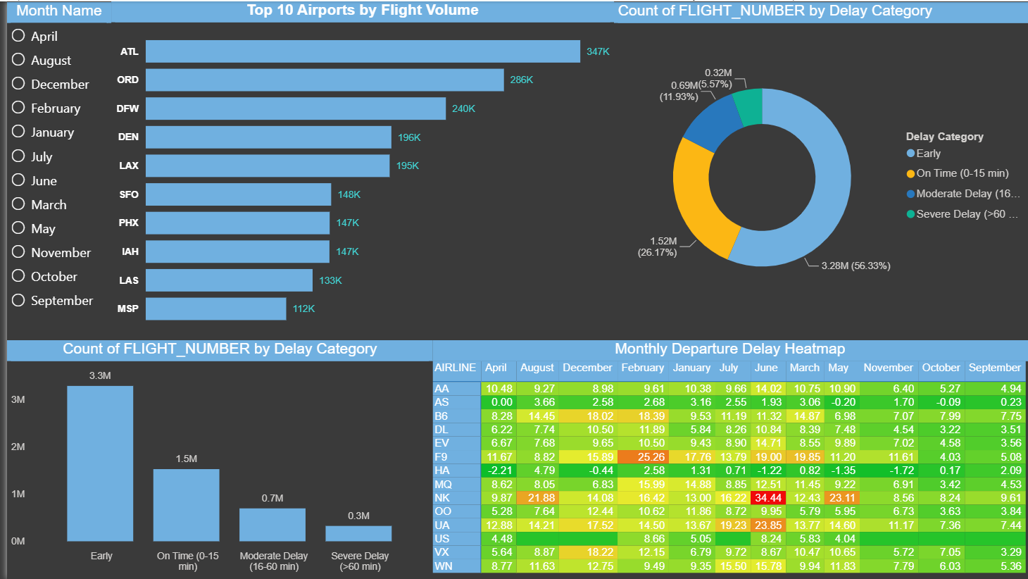
رواد مصر الرقمية
وزارة الاتصالات
وتكنولوجيا المعلومات
Dashboard 2
Airport Volume & Delay Analysis
June 2025
Flight Operations Data Analysis
eyouth
8

Slide 9
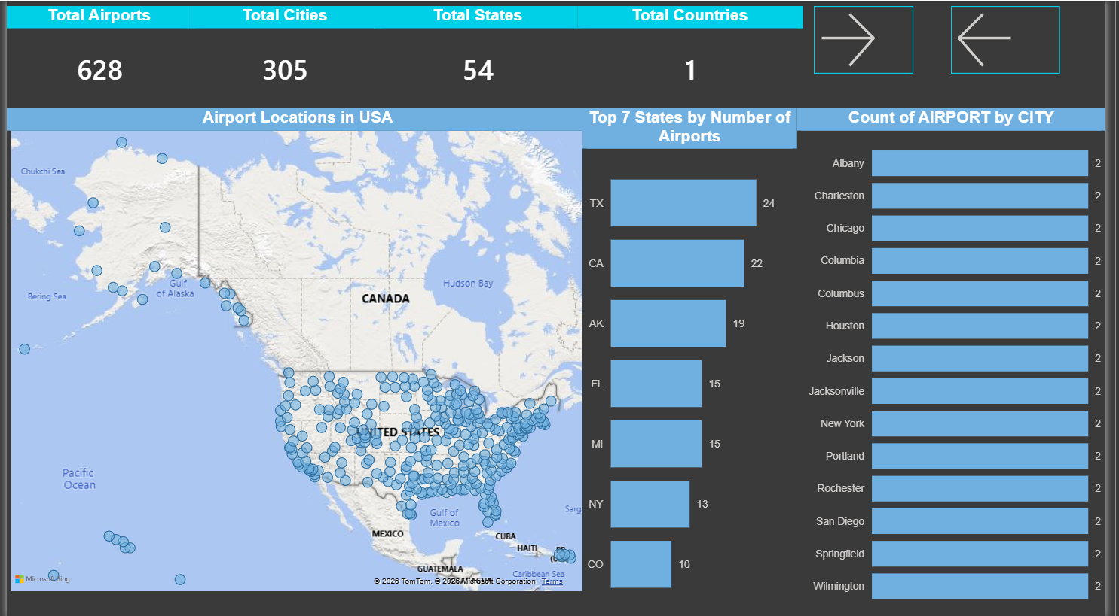
رواد مصر الرقمية
وزارة الاتصالات
وتكنولوجيا المعلومات
Dashboard 3
Geographic Distribution of Airports
June 2025
Flight Operations Data Analysis
eyouth
9

Slide 10
رواد مصر الرقمية
وزارة الاتصالات
وتكنولوجيا المعلومات
Project Team
DEPI — Data Analysis Track
1
Roshdy Mohammed Roshdy Salama
2
Abdelrahman Hany Mohamed
3
Abdalrhman Mohamed Mostafa
Data Analyst
Data Analyst
Data Analyst
4
Mazen Waleed Sayed
5
Asem Wael Rabie Mahfouz
6
Ahmed Khaled Fahmy
Data Analyst
Data Analyst
Data Analyst
June 2025
Flight Operations Data Analysis
eyouth
10

Slide 11
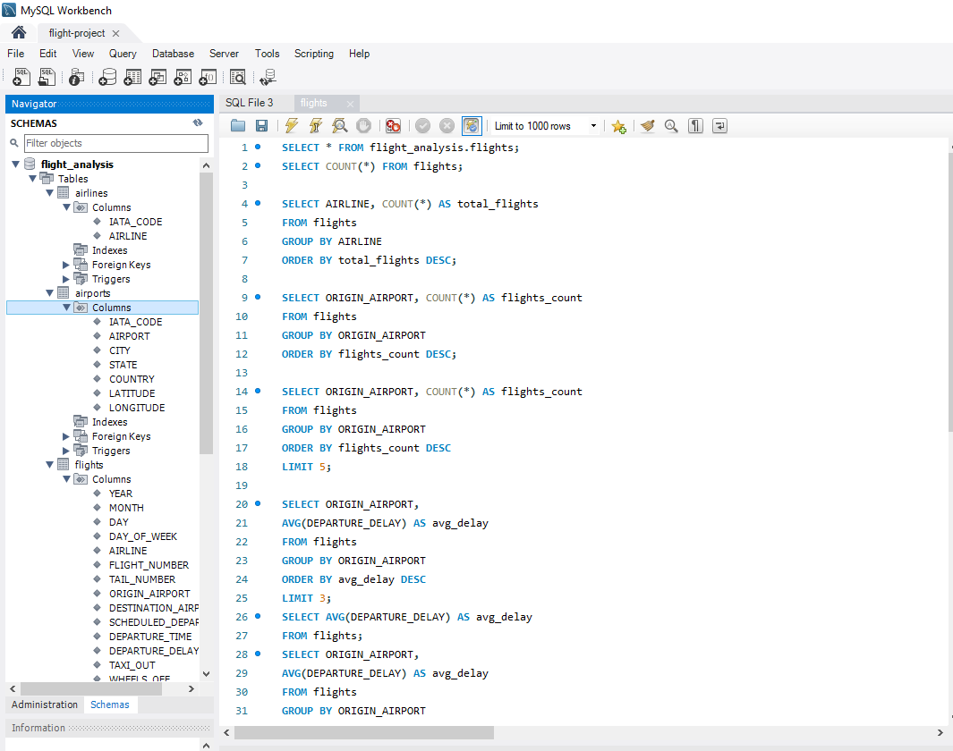

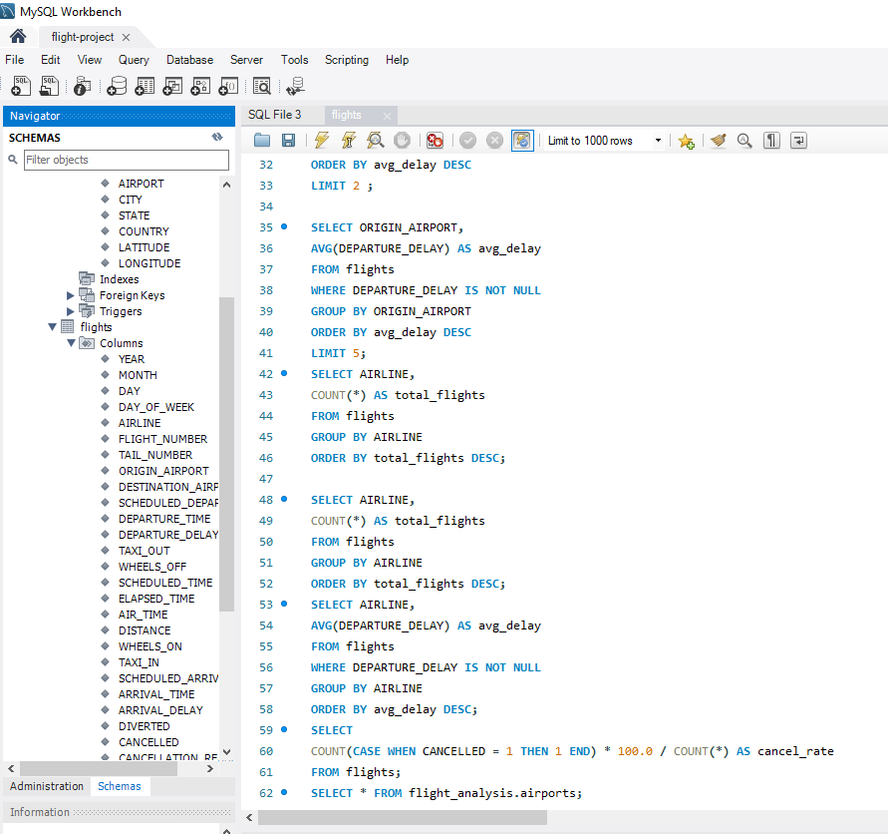
رواد مصر الرقمية
وزارة الاتصالات
وتكنولوجيا المعلومات
MySQL Queries
Database exploration — flight_analysis schema
Key SQL Queries Used
SELECT COUNT(*) grouped by AIRLINE
Total flights per airline, ordered desc
AVG(DEPARTURE_DELAY) by ORIGIN_AIRPORT
Top airports with highest avg delay
AVG(DEPARTURE_DELAY) by AIRLINE
Airline delay performance ranking
CANCELLED rate — CASE WHEN logic
Cancellation % per airline
SELECT * FROM airports — full join
Geo data for map visualization
June 2025
Flight Operations Data Analysis
eyouth
11

Slide 12
رواد مصر الرقمية
وزارة الاتصالات
وتكنولوجيا المعلومات
Key Insights
What the data tells us
63.47%
On-Time Rate
NK Airline
Highest Delay
Majority of flights depart on time or early — showing overall operational health
Spirit Airlines (NK) has the highest avg departure delay — ~14+ minutes
ATL — 347K
Busiest Airport
Feb / June
Worst Months
Atlanta Hartsfield leads flight volume, followed by ORD (Chicago) and DFW (Dallas)
February (winter storms) and June/July (summer demand) show highest delay spikes
June 2025
Flight Operations Data Analysis
eyouth
12

Slide 13
Thank You!
Questions or Feedback?
📊 Project: Flight Operations Analytics Dashboard
🛠️ Tools: MySQL Workbench | Power BI
📅 Date: June 2025
🎓 Program: DEPI — Data Analysis Track
eyouth
رواد مصر الرقمية | وزارة الاتصالات وتكنولوجيا المعلومات

